Slide 1
On the selection of tags for tag clouds (WSDM11)
Advisor: Dr. Koh. Jia-Ling
Speaker: Chiang, Guang-ting
Date:2011/06/20

Slide 2
Preview
Introduction
What’s Tag Cloud
System Model
Metrics
Algorithms
User Model
Experimental Evaluation
Conclusions

Slide 3
Introduction
Present a formal system model for reasoning about tag clouds.
Present metrics that capture the structural properties of a tag cloud.
Present a set of tag selection algorithms that are used in current sites (e.g., del.icio.us,Flickr…).
Devise a new integrated user model that is specifically tailored for tag cloud evaluation.
Evaluate the algorithms under this user model, using two datasets: CourseRank (a Stanford social tool containing information about courses) and del.icio.us (a social bookmarking site).

Slide 4
What’s Tag Cloud
A tag cloud is a visual depiction of text content .
Tag cloud have been used in social information sharing sites, including personal and commercial web pages, blogs, and search engines, such as Flickr and del.icio.us.
Tags in tags cloud are extracted from the textual content of the results and are weighted based on their frequencies.
Tags in the cloud are hyperlinks .

Slide 5
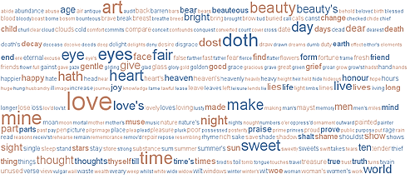
What’s Tag Cloud

Slide 6
What’s Tag Cloud
Goal :
To summarize the available data so the user can better understand what is at his use.
To help users discover unexpected information of interest.

Slide 7
System Model
Goal:
Present a formal system model for reasoning about tag clouds.
Consider :
C : A set of objects (e.g., photos, web pages, etc)
T : A set of tags.
Assume that a query q belongs to T.
Given a query q, the set of results is a set${ C}_{q}⊆\text{C}$ .
$T_{q}$ : the set of tags that are associated with at least one of the objects of $C_{q}$. So we could know $T_{q} ⊆\text{T}$ .
DEFINITION 1. The association set $A_{q}(T)$ of a tag t$∈T_{q}$under query q is the set of objects in $C_{q}$ associated with tag t .

Slide 8
Object1 | Object2 | Object3
A | A | B
C | C | D
 | D
C: Object 1、Object 2、Object 3
T : A、B、C、D
q : A
$C_{q}$ : Object 1、Object 2
$T_{q}$ : A、C、D
$A_{q}(C)$ : Object 1、Object 2
$A_{q}(D)$ : Object 2

Slide 9
System Model
partial (scoring) function : s(q , $C_{q}$ ) : T×C →[0 , 1].
For a query q, the scoring function establishes a partial ordering between objects in Cq.
EX: if s(q , $C_{i}$ ) > s(q , $C_{j}$ ), then Ci is ranked higher than Cj .
similarity function : sim($C_{i}$ , $C_{j}$ ) : C×C →[0 , 1].
The higher the value of sim($C_{i}$ , $C_{j}$ ) is, the more similar the two objects are.

Slide 10
Metrics
Goal :
Present metrics that capture the structural properties of a tag cloud.
For a set of objects $C_{p}$ $⊆$C:
| $C_{p}$ | : the number of elements in $C_{p}$.
| $C_{p}$|s,q =$\sum_{c∈Cp}{s\left(q,c\right)}$: the scored size of the set $C_{p}$under query q.
The higher the score of an element is, the more it contributes to the sum.
| $C_{p}$|1-s,q =$\sum_{c∈Cp}{\{1−s\left(q,c\right)\}}$:the (1-s)-scored size of the set $C_{p}$ under query q.
The higher the score of an element is, the less it contributes to the sum.
S: a subset(tag cloud) of $T_{q}$ .

Slide 11
11
Object1 | Object2 | Object3
A | A | A
C | C | B
 | D | D
C: Object 1、Object 2、Object 3
T: A、B、C、D
q : A
$C_{q}$ : Object 1、Object 2、 Object 3
$T_{q}$ : A、B、C、D
$A_{q}(C)$ : Object 1、Object 2
$A_{q}(D)$ : Object 2、Object 3
| $C_{q}$ | : 3
| $C_{q}$|s,q =$\sum_{c∈Cq}{s\left(q,c\right)}$:
=0.5+0.3+0.3 =1.1
| $C_{q}$|1-s,q =$\sum_{c∈Cp}{\{1−s\left(q,c\right)\}}$:
=0.5+0.7+0.7 =1.9
 | $$s\left(q,c\right)$$ | 1- $s\left(q,c\right)$
O1 | 0.5 | 0.5
O2 | 0.3 | 0.7
O3 | 0.3 | 0.7

Slide 12
Metrics
Object1 | Object2 | Object3
A | A | A
C | C | B
 | D | D
Extent of S :
the large the extent of S is , the more topic S potentially covers.
$ext\left(s\right)=|s|$
Coverage of S :
Coverage gives us the fraction of $C_{q}$ covered by S.
cov(S)$=\frac{{|\bigcup_{t∈S}{Aq\left(t\right)|}}_{s,q}}{{|Cq|}_{s,q}}$ , [0 , 1]
Assume S=(C、D)
$ext\left(s\right)=|s|$ = 2
 | $$s\left(q,c\right)$$ | 1- $s\left(q,c\right)$
O1 | 0.5 | 0.5
O2 | 0.3 | 0.7
O3 | 0.3 | 0.7
If(t=C) $=\frac{{|A_{q}\left(C\right)|}_{s,q}}{{|Cq|}_{s,q}}$ = 0.5+0.3 / 1.1 = 72%
If(t=D) =$\frac{{|A_{q}\left(D\right)|}_{s,q}}{{|Cq|}_{s,q}}$ = 0.3+0.3 / 1.1 = 54%

Slide 13
Metrics
Object1 | Object2 | Object3
A | A | A
C | C | B
 | D | D
Overlap of S :
The overlap metric captures the extent of such redundancy .
1
, [0 , 1]
S = (C、D)
$\frac{O2}{\min{\{\left|O1+O2\right|},|O2+O3|\}}$= $\frac{0.7}{min⁡\{\left|0.5+0.7\right|,\left|0.7+0.7\right|\}}$ = $\frac{0.7}{1.2}$ = 58%
 | $$s\left(q,c\right)$$ | 1- $s\left(q,c\right)$
O1 | 0.5 | 0.5
O2 | 0.3 | 0.7
O3 | 0.3 | 0.7

Slide 14
Metrics
Object1 | Object2 | Object3
A | A | A
C | C | B
 | D | D
Cohesiveness of S :
How closely related the objects in each association set of S are.
define the average similarity of the association set $A_{q}(t)$ of a tag t $∈$S based on the pair-wise similarities of the objects in $A_{q}(t)$.
1
, [0 , 1]
1 [0 , 1]
The higher coh(S) is, the more similar the objects in the association sets are to each other.
$\overline{sim\left(C\right)}$ = $\frac{sim(O1,O2)}{2∗1}$ = 0.8/2 =0.4
$\overline{sim\left(D\right)}$ = $\frac{sim(O2,O3)}{2∗1}$ = 0.6/2 =0.3
coh(S) = (0.4+0.3) / 2 =0.35

Slide 15
Metrics
Object1 | Object2 | Object3
A | A | A
C | C | B
 | D | D
Relevance of S :
How relevant the tags in S are to the original query q.
$rel\left(t,q\right)=\frac{|C_{t}∩C_{q}|}{|C_{t}|}$ .
1 ,[0 , 1]
S={c、d}
$rel\left(c,a\right)=\frac{|C_{c}∩C_{a}|}{|C_{c}|}$ = 2/2 = 1
$rel\left(d,a\right)=\frac{|C_{c}∩C_{a}|}{|C_{c}|}$ = 2/2 = 1

Slide 16
Metrics
Object1 | Object2 | Object3
A | A | A
C | C | B
 | D | D
Popularity of S :
A tag from S is popular in $C_{q}$if it is associated with many objects in $C_{q}$.
$\frac{{|A}_{q(C)}|+{|A}_{q\left(D\right)|}}{max{\{|A}_{q\left(B\right)|}|+{|A}_{q\left(C\right)}|\}+\{|A_{q\left(B\right)}+{|A}_{q\left(D\right)|}|\}+\{{|A}_{q\left(C\right)}|\}+|A_{q\left(D\right)}\}}$ = $\frac{2+2}{\left|1+2\right|,\left|1+2\right|,|2+2|}$ = $\frac{4}{4}$ = 1

Slide 17
Metrics
Independence of S:
All objects in the association set of a tag $t_{1}$may be similar to each other but they may be also similar to the objects in the association set of a second tag $t_{2}$.
,[0,1]
S = (C、D) q=A
$A_{q}(C)$ : Object 1、Object 2
$A_{q}(D)$ : Object 2、Object 3
$\frac{sim(O1,O2)+sim(O1,O3)+sim(O2,O2)+sim(O2,O3)}{{|A}_{q}\left(C\right)|∗|A_{q}(D)|}$
$=\frac{0.8+0.4+1+0.6}{2∗2}$ = $\frac{2.8}{4}$ =0.7
Ind(S) = 1-0.7 = 0.3
Object1 | Object2 | Object3
A | A | A
C | C | B
 | D | D

Slide 18
Metrics
Balance of S :
To take into account the relative sizes of association sets.
, [0,1] .
The closer it is to 1, the more balanced our association sets are.
S = (C、D) q=A
$A_{q}(C)$ : Object 1、Object 2、 Object 3
$A_{q}(D)$ : Object 2
bal(S) = $\frac{1}{3}$
Object1 | Object2 | Object3
A | A | A
C | C | B
 | D | C

Slide 19
Algorithms
Goal :
Present a set of tag selection algorithms that are used in current sites (e.g., del.icio.us,Flickr…).
A tag selection algorithm can be single or multi-objective.
A single-objective algorithm has a single goal in mind.
A multi-objective algorithm tries to strike a balance among two or more goals.
In this paper we focus on four single objective algorithms that have been used in practice or that are very close to those used.

Slide 20
Algorithms
Popularity algorithm (POP)
Showing popular tags in the cloud allows a user to see what other people are mostly interested in sharing.
For a query q and parameter k, the algorithm POP returns the top-k tags in $T_{q}$ according to their $|A_{q}\left(t\right)|$ .
Query :q
Parameter :k
Pop(S)
Top-k tags

Slide 21
Algorithms
Tf-idf based algorithms (TF, WTF)
A different approach is to select good quality tags for the cloud.
By giving preference to tags that seem very related when compared against the objects in $C_{q}$.
The algorithm produces a score for t by aggregating the values of a function f(q, t , c) over all objects c$∈A_{q}(t)$; this aggregation yields a score w for tag t.

Slide 22
Algorithms
Function f(q , t , c) can have the following forms:
f (q , t , c) = s(t , c) ---- tf-idf (TF for short)
f (q , t , c) = s(t , c) · s(q , c) ---- weighted tf-idf (WTF)
The first form of f(q , t , c) uses the scoring function s to capture how related tag t and an object c $∈$ $A_{q}(t)$ are.
The second form of f(q , t , c) weighs the relatedness between t and c, s(t , c) , by how related object c is to the query q.

Slide 23
Algorithms
Maximum coverage algorithm (COV)
Trying to maximize the coverage of the resulting set of tags S with the restriction that |S| $∈$k.
It starts with an empty S.
Then, at each round, it adds a tag to S from $T_{q}$ that covers the largest number of uncovered objects by that point.
The algorithm stops after adding k tags to S or when there are no more tags in $T_{q}$.

Slide 24
User Model
Goal :
Devise a new integrated user model that is specifically fit well for tag cloud evaluation and assumes an “ideal” user.
This “ideal” user is satisfied in a very predictable and rational way.
Base model: Coverage
Incorporating Relevance
Incorporating cohesiveness
Incorporating Overlap
Proposed User Model

Slide 25
User Model
Base model: Coverage
O : the union of the $A_{q}(t)$ sets for all t $∈$ S .
Assume that overlap is 0 and that s(q , c) = 1 for all c $∈$ $C_{q}$ .
Assume that each object in $C_{q}−$O has probability p of being the one the user is interested in, and O have probability r·p , where r > 1 .
Parameter r captures how correlated the content of the tag cloud is to the user intention .
Object1 | Object 2 | Object3 | Object4
A | A | A | A
C | C | B | B
 | D | D
S = (C、D) q=A
$A_{q}(C)$ : Object 1、Object 2
$A_{q}(D)$ : Object 2、Object 3
O:O1、O2、O3
$C_{q}$ :O1、O2、O3、O4
$C_{q}−$O=O4

Slide 26
User Model
r = 2, $C_{q}$has 10 objects, and O has 6 objects and the user is
interested in 1 object.
6·r·p+(10-6) ·p =1. p = 1/16 = 0.0625.
reachable probability : 6·2·1/16=12/16=0.75.
failure probability :(10-6) ·p = 4/16=0.25.
DEFINITION 2.
The failure probability (F) for a query q is the probability
that the user will not be able to satisfy his search need
using the tag cloud S.

Slide 27
User Model
Incorporating Relevance
We still assume that overlap is 0 and that s(q , c) = 1 for all c $∈$ $C_{q}$, but now incorporate coverage and relevance.
For an object c $∈$ $A_{q}(t)$ the probability that it is of the user’s interest is
p+(r-1) ·$\frac{A_{q}(t)}{C_{t}}$ ·p.
r = 2, $C_{q}$has 10 objects |$A_{q}(t_{1})$|=|$A_{q}(t_{2})$|=3 |$C_{t1}$|=|$C_{t2}$|=10
Then each of the $t_{1}$(and $t_{2}$) objects has a likelihood of
p+0.3·(r-1)·p=1.3p of being interesting for the user.
Since the probability over all objects is 1.
6· (1.3p)+(10-6) ·p =1 p=1/11.8 =0.085
Probability of failure is F=(10-6)·p=0.34.

Slide 28
User Model
Incorporating cohesiveness
Assume that overlap is 0 and that s(q , c) = 1 for all c$∈C_{q}$. Our current model incorporates coverage, relevance, and cohesiveness. For an object c $∈$ $A_{q}(t)$ the probability that it is of the user’s interest is p+(r-1)·$\overline{\text{sim}\text{(}\text{t}\text{)}}$ ·$\frac{A_{q}(t)}{C_{t}}\text{·}$p.

Slide 29
User Model
Incorporating Overlap
Say the object c appears in multiple association sets, $A_{q}(t_{1})$, $A_{q}(t_{2})$,. . . , $A_{q}(t_{l})$ .
We get from $t_{1}$ that c has probability $p_{1}$= p+(r-1)·$\overline{\text{sim}\text{(}t_{1}\text{)}}$ ·$\frac{A_{q}(t_{1})}{C_{t_{1}}}\text{·}$p, from $t_{2}$probability $p_{2}$= p+(r-1)·$\overline{\text{sim}\text{(}t_{2}\text{)}}$ ·$\frac{A_{q}(t_{2})}{C_{t_{2}}}\text{·}$p etc.
We assume the object will not be of interest if it is not of interest as each tag is considered, i.e., with probability (1-$p_{1}$) ·(1-$p_{2}$) ·…(1-$p_{l}$).
The probability the object is of interest is 1-(1-$p_{1}$) ·(1-$p_{2}$) ·…(1-$p_{l}$).

Slide 30
User Model
Taking into account scores
Pr[c] : for each object c its probability of being of interest to the user.
Pr[c]’ : the final probability by first multiplying every Pr[c] with s(q, c).

Slide 31
Experimental Evaluation
Goal :
Evaluate the algorithms under this user model, using two datasets: CourseRank and del.icio.us .
CourseRank:
A set of 18,774 courses that Stanford University offers annually.
Each course represents an object in C.
We consider all the words in the course title, course description and user comments to be the tags for the object, except for stop words and terms are very frequent and do not describe the content of the course.
del.icio.us:
Consists of urls and the tags that the users assigned to them on del.icio.us. Our dataset contains a month worth of data (May 25, 2007–June 26, 2007); we randomly sampled 100,000 urls and all the tags that were assigned to these 100,000 urls during that month.

Slide 32
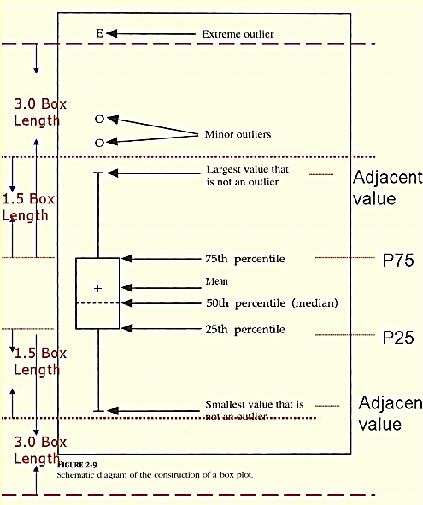
Box plot

Slide 33
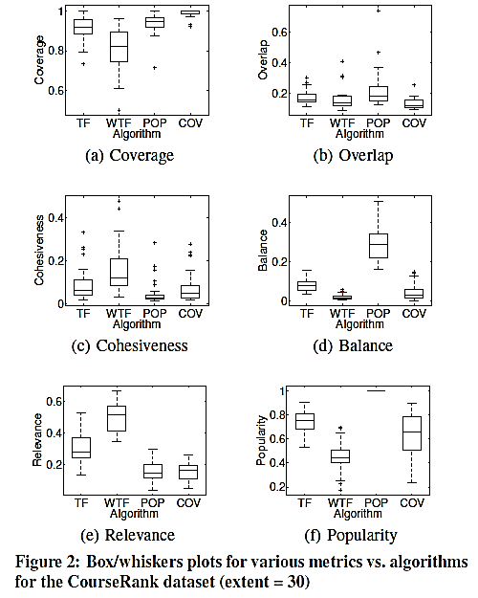
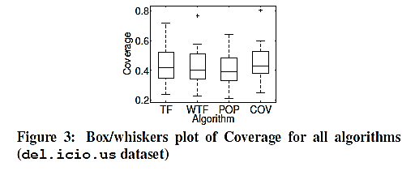
The algorithms impact
metrics differently

Slide 34
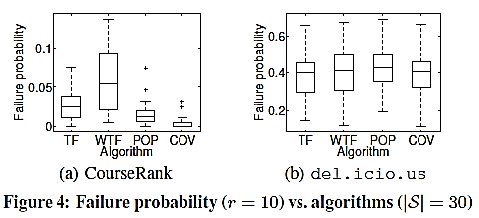
Experimental Evaluation
Algorithms impact failure probability differently
The lower the failure probability is, the more likely it is that one of the displayed tags will lead to an object of interest.

Slide 35
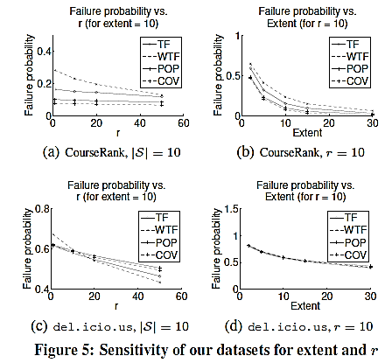
Experimental Evaluation
How the ordering of the algorithms change for different extent and r values.
Notes:
failure probability decreases as each of these parameters increase, but more interestingly the ordering of the algorithms stays the same (first COV, then POP, TF and WTF).
when r is less than about 15, the ordering (best to worst) is TF, COV, POP and finally WTF. However, as r increases WTF becomes the best.

Slide 36
Conclusions
Our goal has been to understand the process of building a tag cloud for exploring and understanding a set of objects.
Under our user model, our maximum coverage algorithm, COV seems to be a very good choice for most scenarios.
Our user model is a useful tool for identifying tag clouds preferred by users.

Slide 37
3Q 4 UR ATTENTION !!!!!!!!!

Slide 38
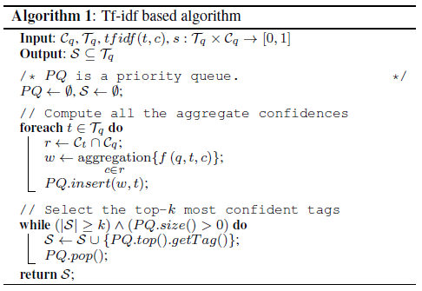
Algorithms

